Slide 1


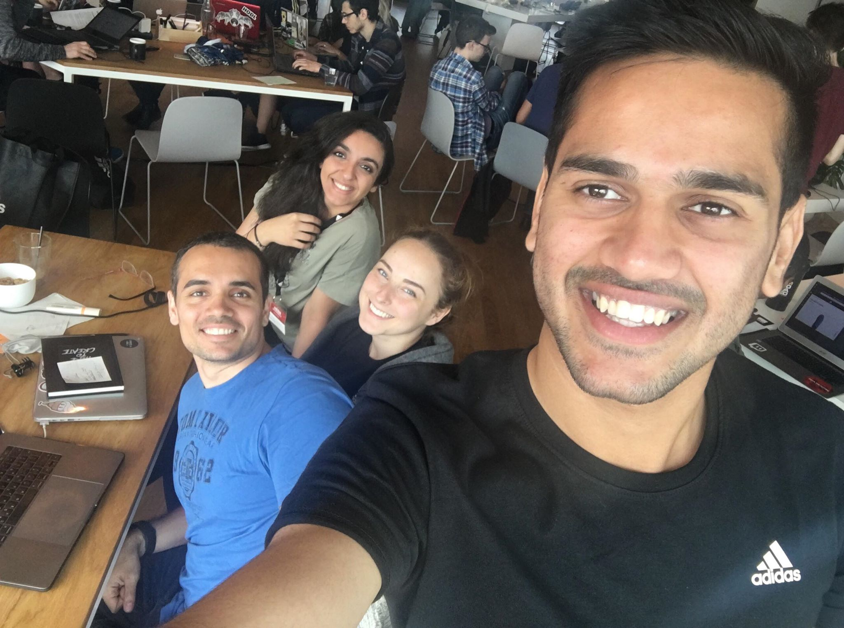


WebX
TEAM PICTURE
Hashir Rizwan
Georgios Fandridis
Gintare Gabriella Rozenaite
Nazrin Guliyeva
NEXT GEN SHOPPING
Machine Learning
Web Development
TECHNOLOGIES
Big Data
AR & VR

